Slide 1


Slide 2
To Mob*, Pair, or Fly Solo
ACCU Conference 2024
*Ensemble
Chris Oldwood
Notes:
Who am I? What’s my background in ensemble programming?
Sceptic – programming not about what I thought it was.

Slide 3
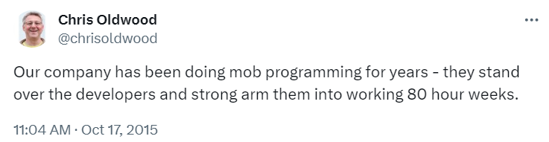
A Note on Terminology

Slide 4
Productivity
The elephant in the room

Slide 5
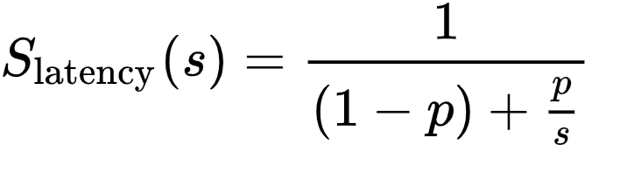
Amdahl's Law

Slide 6
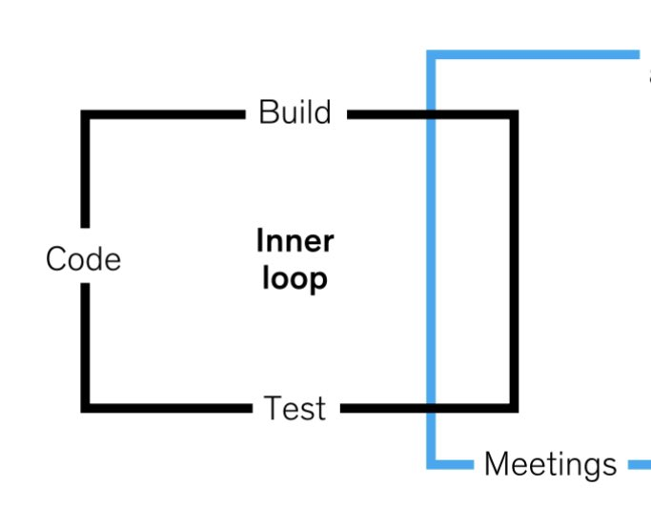
“The McKinsey Loop”

Slide 7

Gilb’s Law
“Anything you need to quantify can be measured in some way that is superior to not measuring it at all.”
-- Tom Gilb, Peopleware

Slide 8
Poor Measurements
Lines of code / functions
Commits / pull requests
Bugs fixed / tickets closed
Hours worked

Slide 9
Goodhart's Law
“When a measure becomes a target, it ceases to be a good measure.”

Slide 10
Agile Manifesto
“Working software is the primary measure of progress”

Slide 11
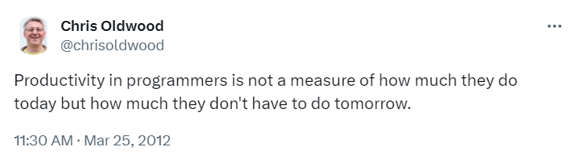
The Long Game

Slide 12

Gall’s Law
“A complex system that works is invariably found to have evolved from a simple system that worked.”
-- John Gall, Systemantics (aka The Systems Bible)

Slide 13

Flow vs Efficiency

Slide 14
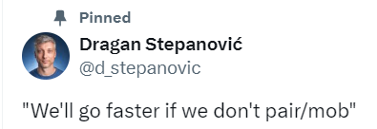
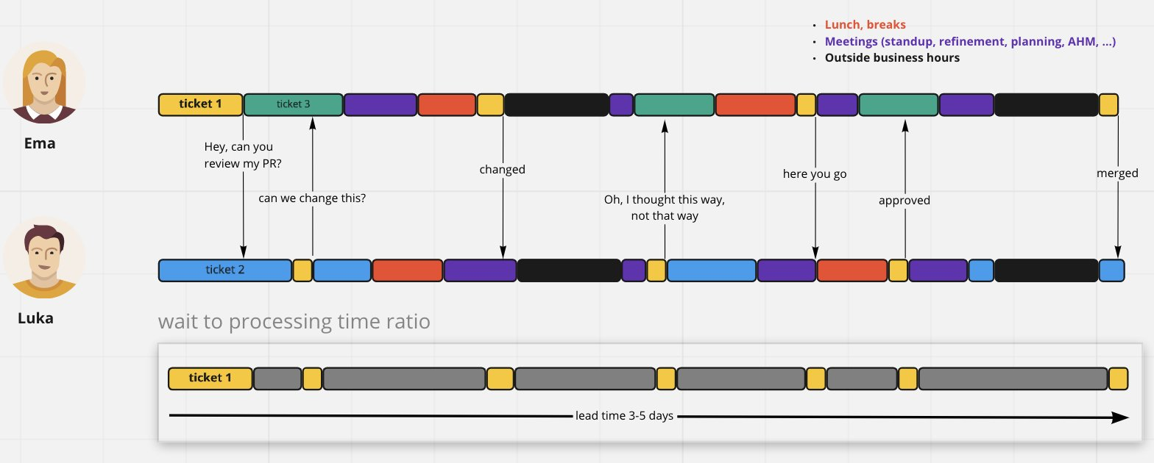
https://x.com/d_stepanovic/status/1379451260638785536

Slide 15
Collaboration
Sharing knowledge and a vision

Slide 16

Egoless Programming
“…If asked, most programmers would probably say they preferred to work alone in a place where they wouldn’t be disturbed by other people… The ideas expressed in the preceding paragraph are possibly the most formidable barrier to improved programming that we shall encounter.”
-- Gerry Weinberg, The Psychology of Computer Programming, 1971.

Slide 17
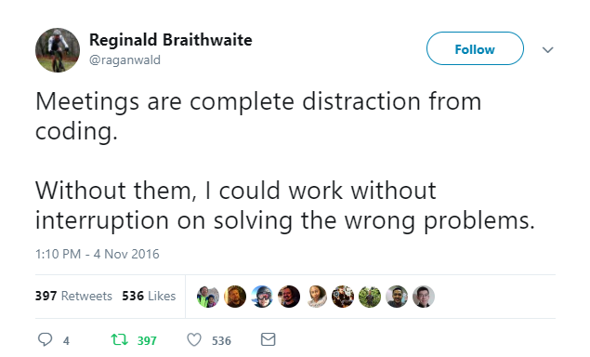
Meetings are Collaboration

Slide 18
Collaboration Aphorisms
“Two heads are better than one”
“Many hands make light work”
“The wisdom of crowds”
“A rising tide lifts all boats”
“A problem shared is a problem halved”

Slide 19
Newton’s Third Law?
“Too many cooks spoil the broth”

Slide 20
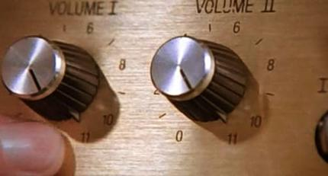
Turning Up The Dial
https://en.wikipedia.org/wiki/File:Spinal_Tap_-_Up_to_Eleven.jpg

Slide 21
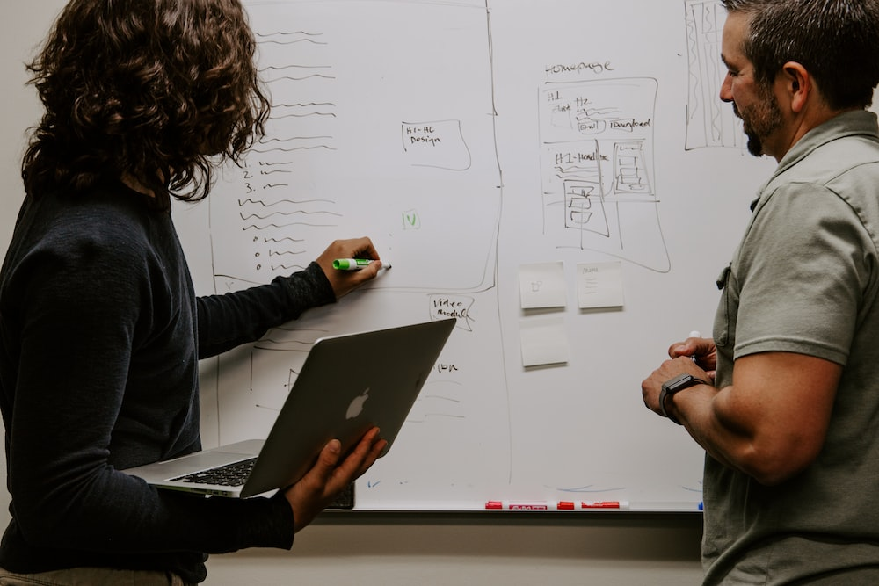
Shared Understanding
https://unsplash.com/photos/3V8xo5Gbusk

Slide 22
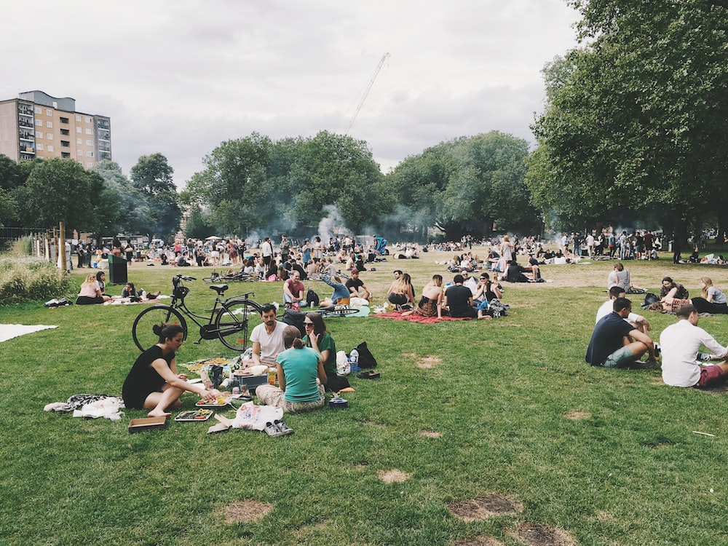
Shared Ownership
https://unsplash.com/photos/4hcpIbqQM8c

Slide 23

Continuous Improvement
https://unsplash.com/photos/kcT-7cirBEw

Slide 24
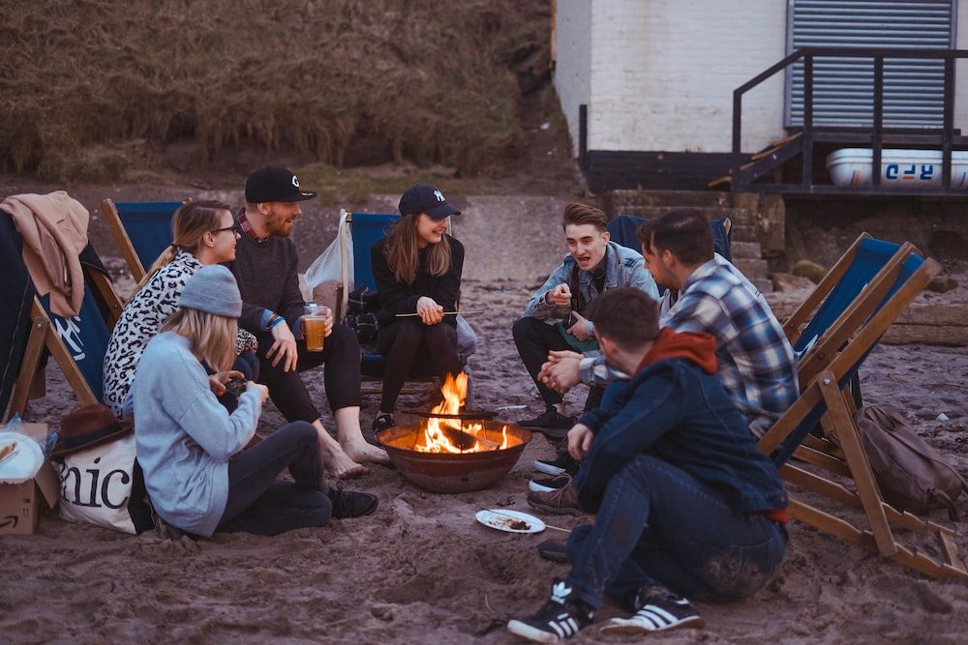
It’s Fun!
https://unsplash.com/photos/x9I-6yoXrXE

Slide 25
Ensemble Programming
Focusing the team

Slide 26
Pair Programming
Programming in small teams

Slide 27
Flying Solo
Administration & education

Slide 28

Ebbs & Flows
https://unsplash.com/photos/body-of-water-under-sky-6ArTTluciuA

Slide 29
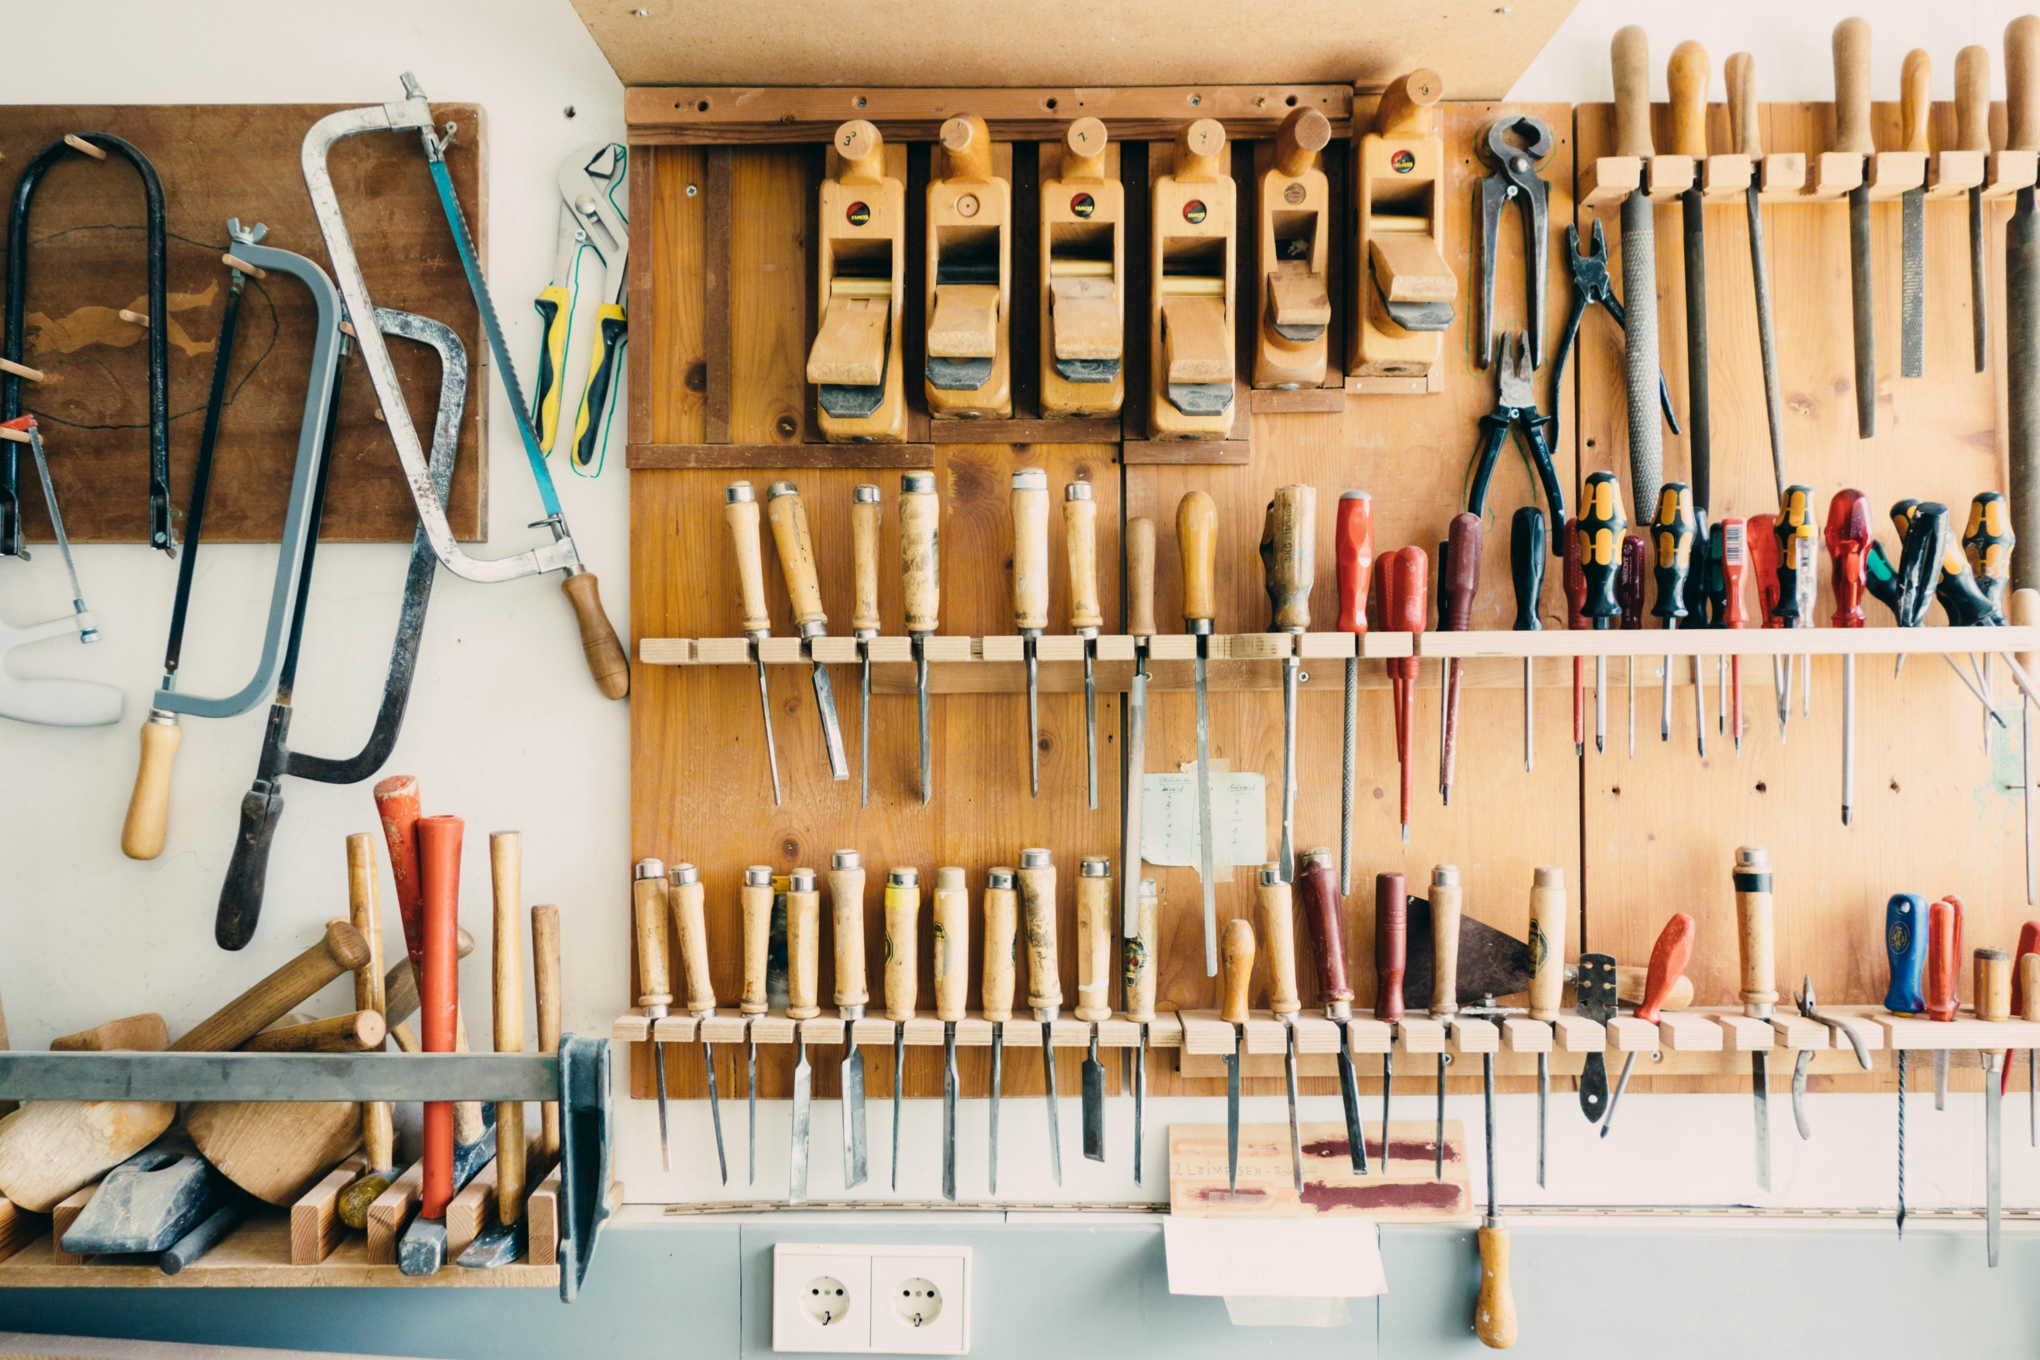
Tooling
https://unsplash.com/photos/assorted-handheld-tools-in-tool-rack-t5YUoHW6zRo

Slide 30

Literature

Slide 31
Clocking Off
Blog:
http://chrisoldwood.blogspot.co.uk Articles:
http://chrisoldwood.com/articles.htm C Vu 30-5: To Mob, Pair, or Fly Solo: http://www.chrisoldwood.com/articles/to-mob-pair-or-fly-solo.html

